Slide 1
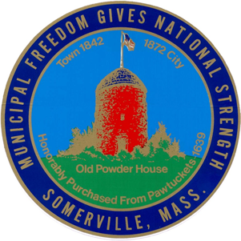

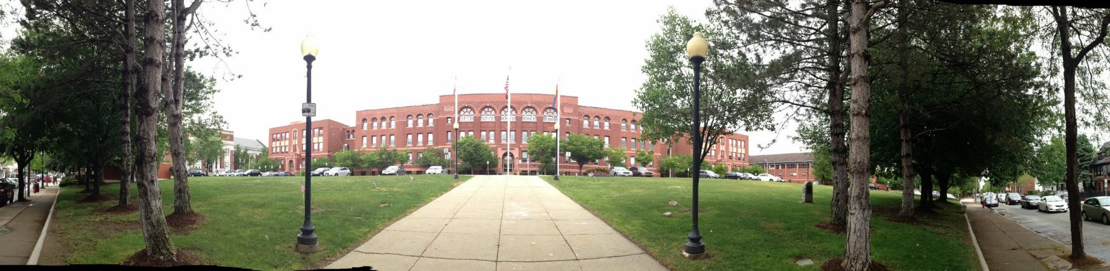


Somerville High School
Board of Alderman: Financial Sub-Committee
July 6, 2016

Slide 2
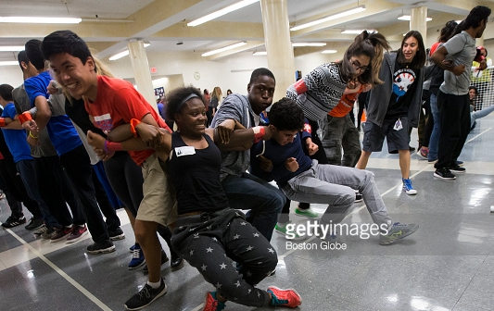
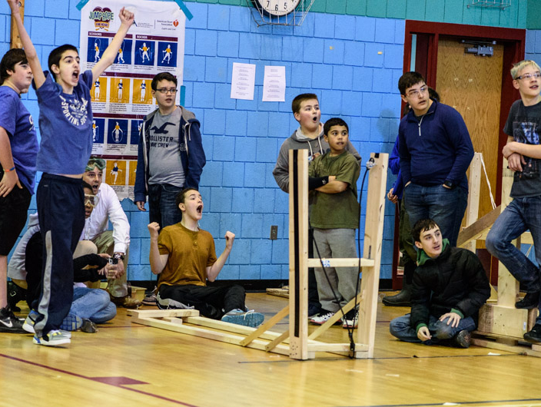
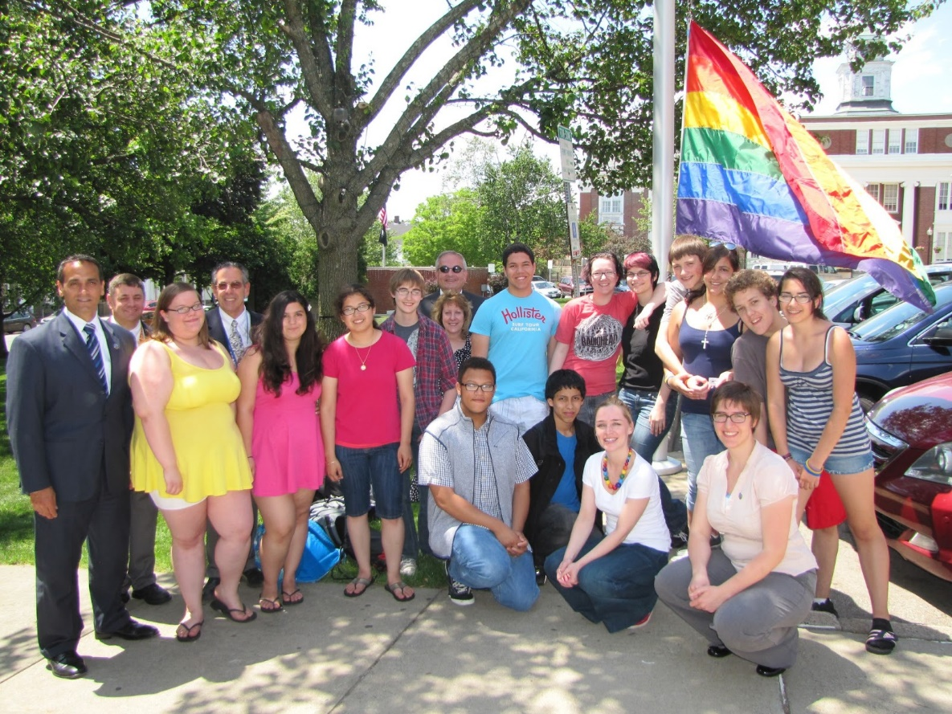
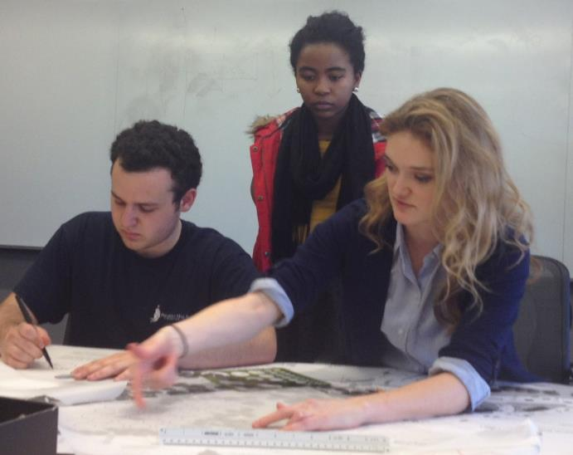

Slide 3
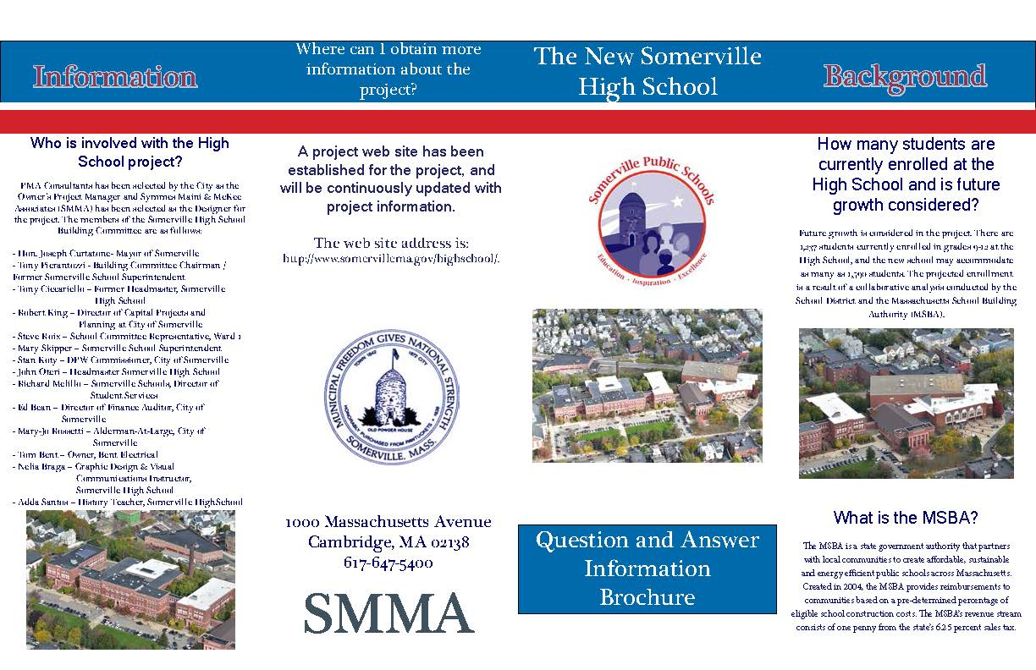
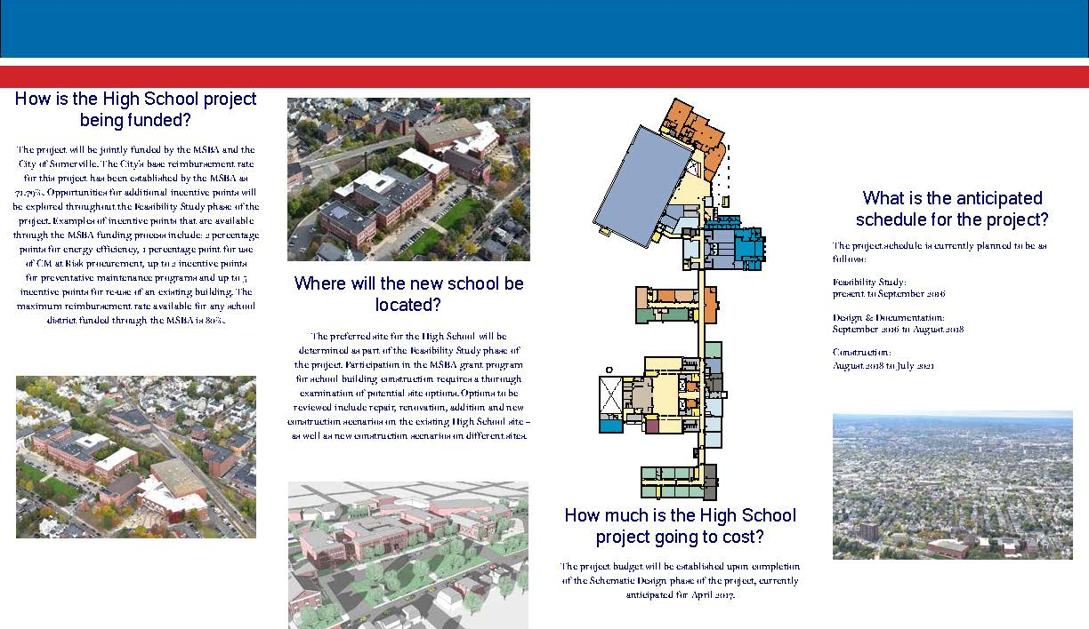
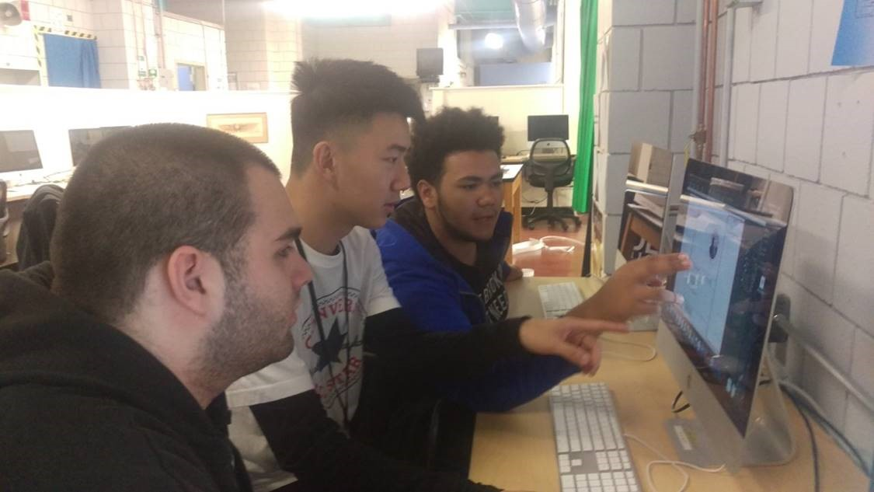
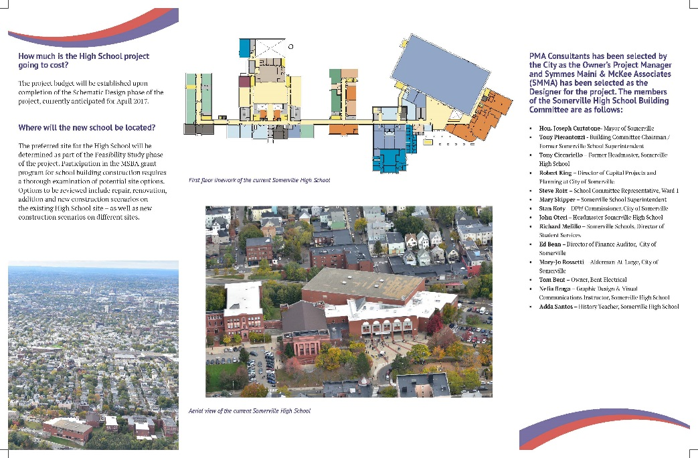
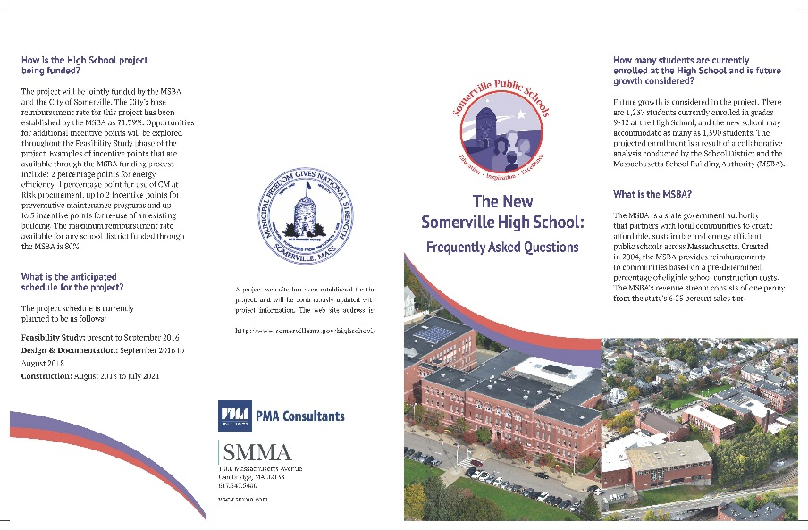
Wide Project Involvement:
School Building Committee
(City Appointed – MSBA Requirement)
City of Somerville & Residents
Massachusetts School Building Authority (MSBA)
Department of Elementary & Secondary Education (DESE)
Somerville Historic Preservation Commission
Educational Visioning & Planning with Staff, Teachers, and Community
Students

Slide 4
Somerville High School
Tonight’s Agenda:
Mayor’s Opening Remarks and Introductions
Why SHS? & Why Now?
Project Overview
Educational Vision and Planning Considerations
Project Cost History, Market and Next Steps
Closing Remarks

Slide 5
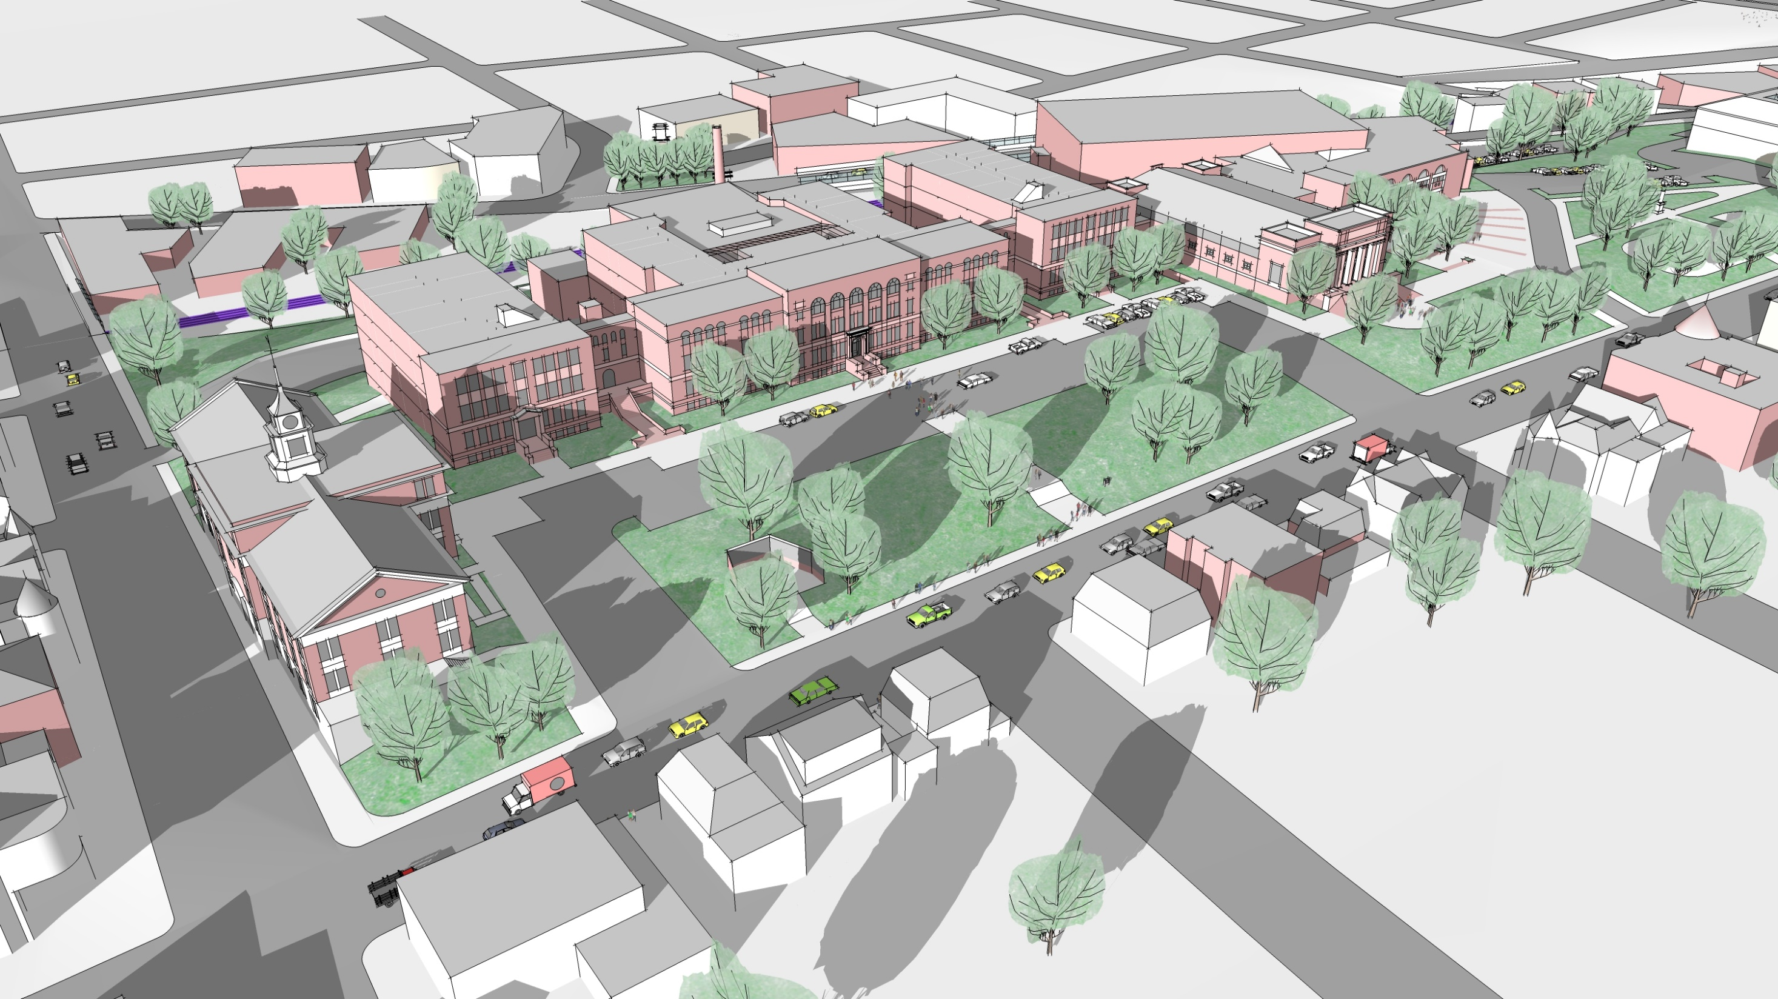

Slide 6
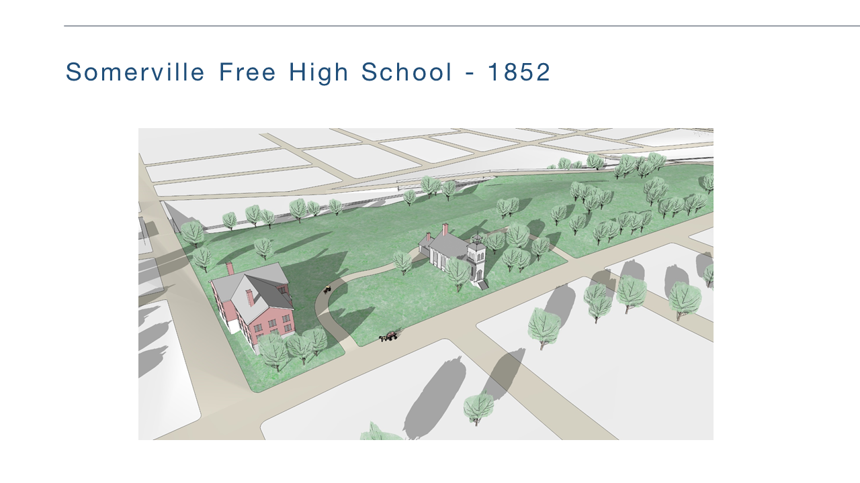
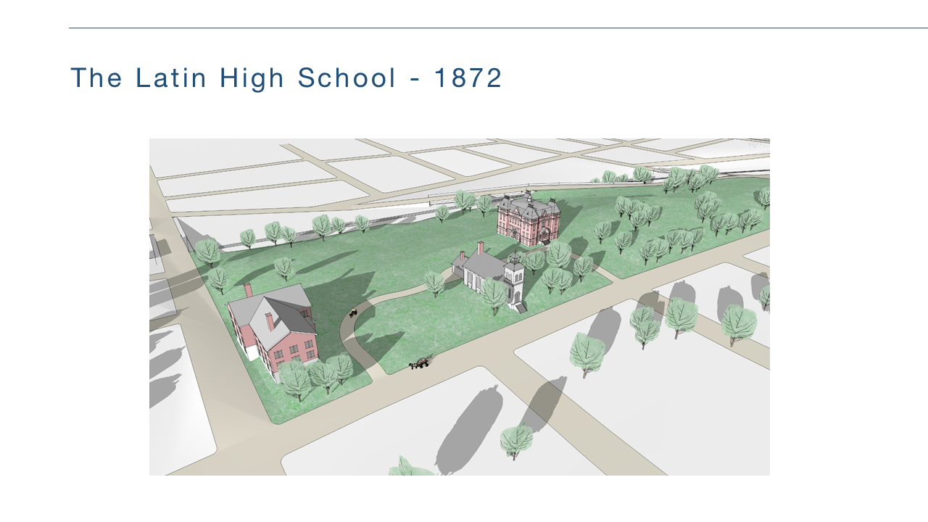
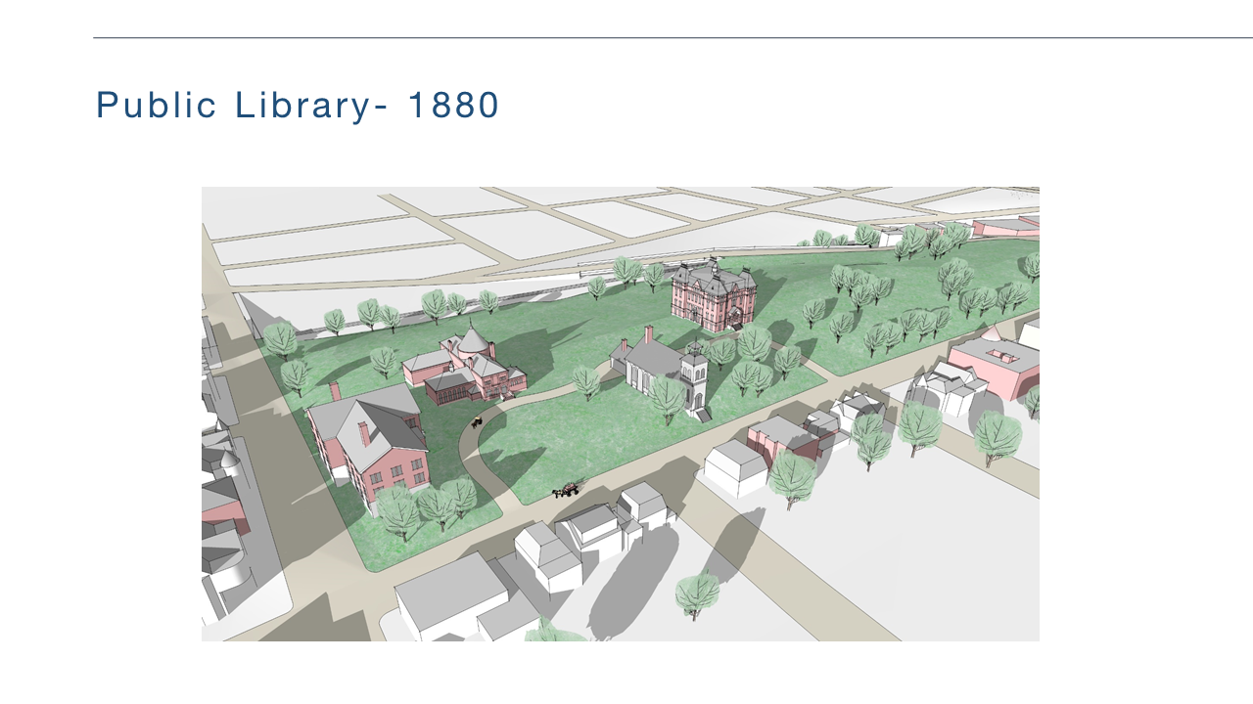
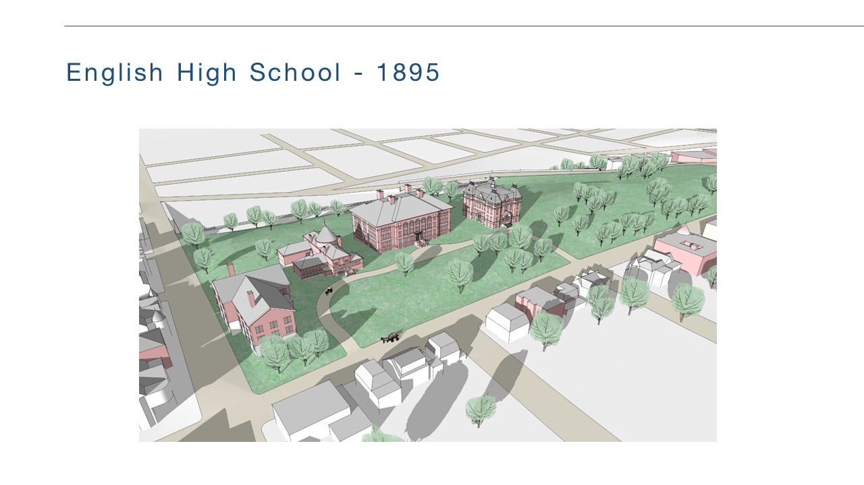
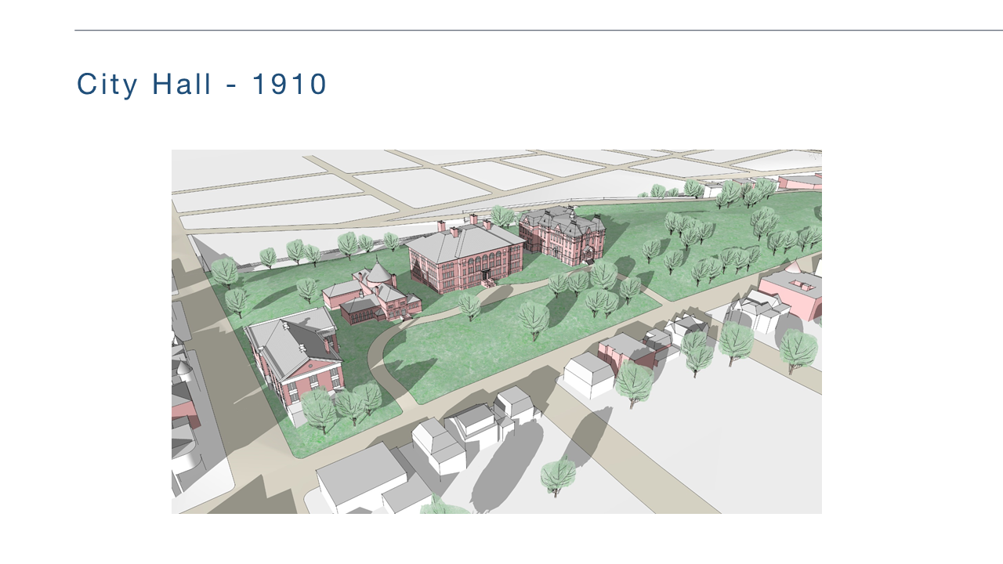
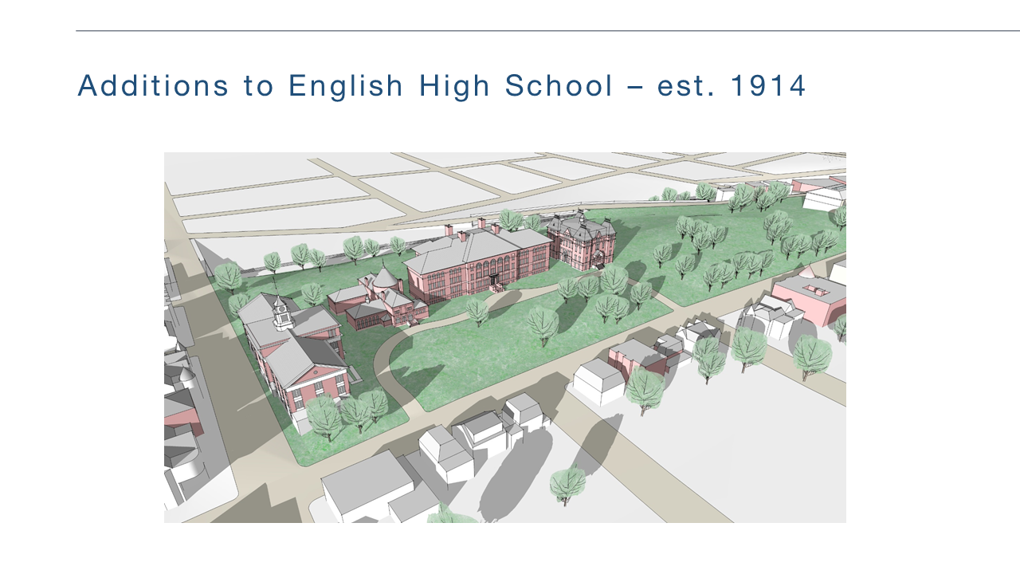
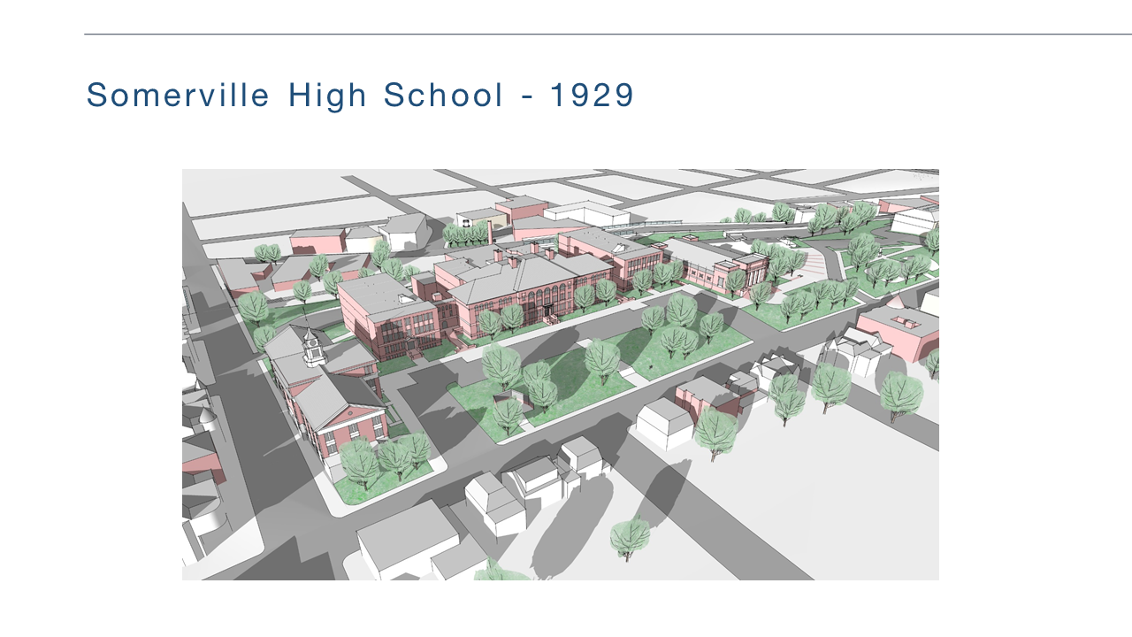
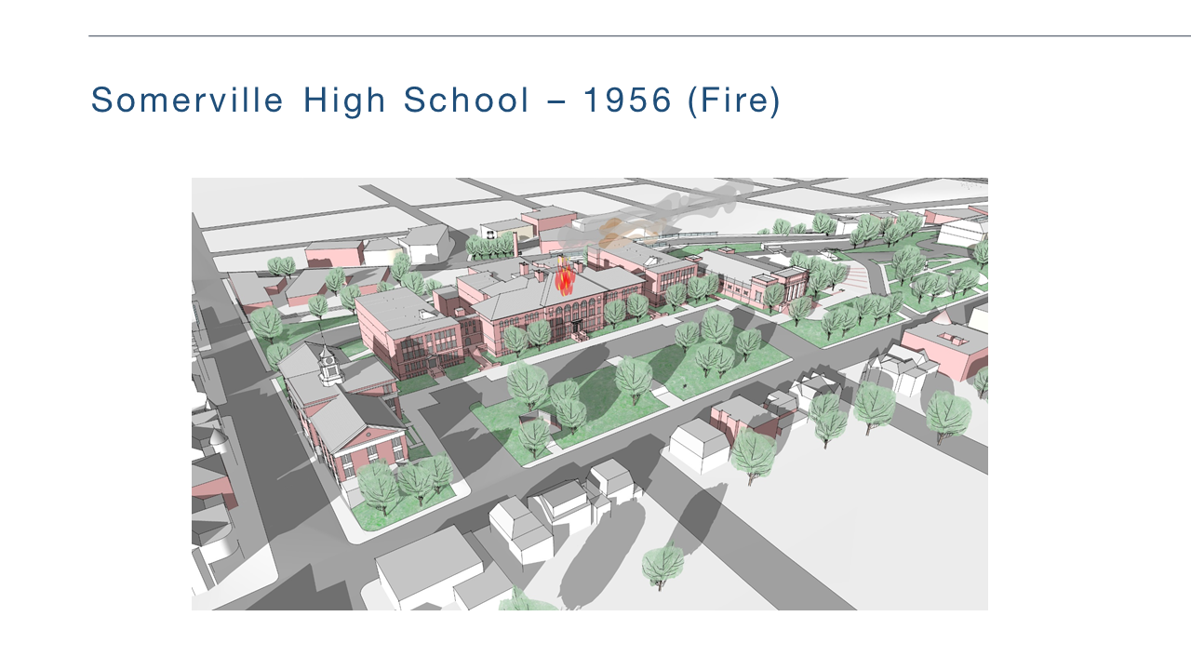

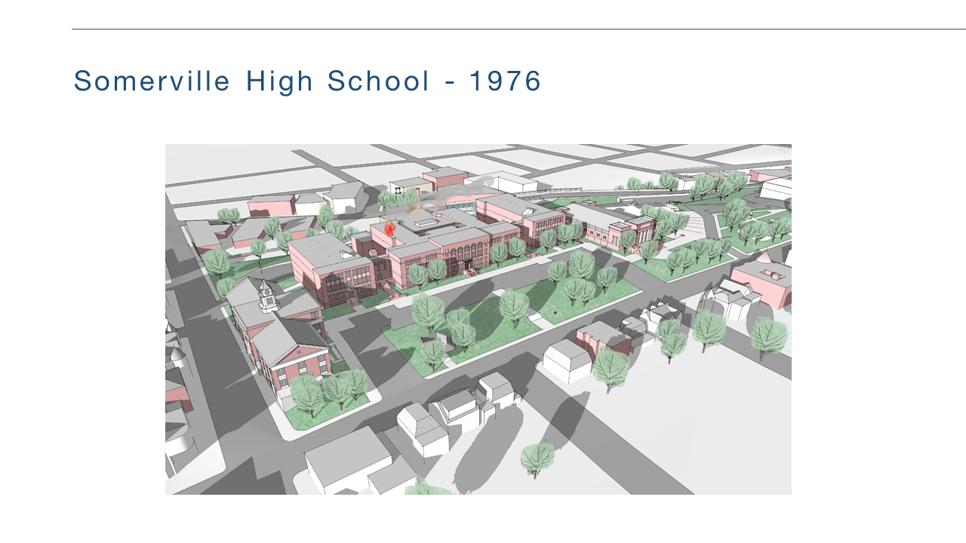
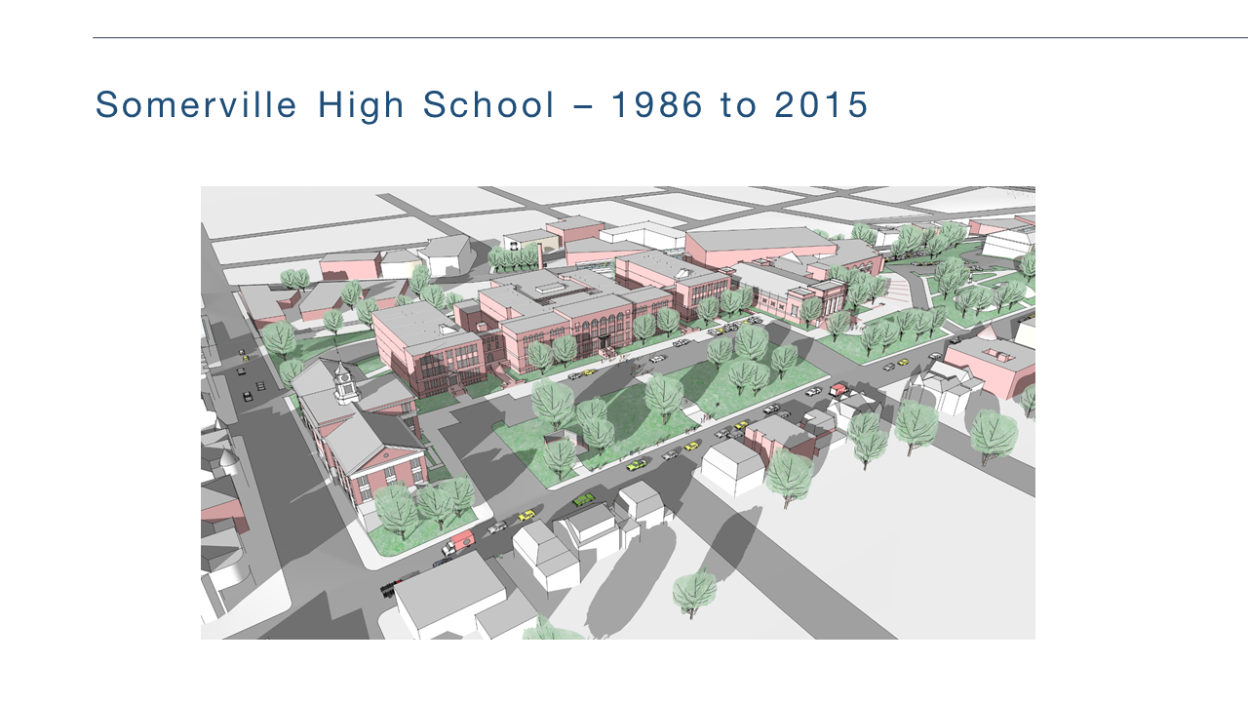

Slide 7
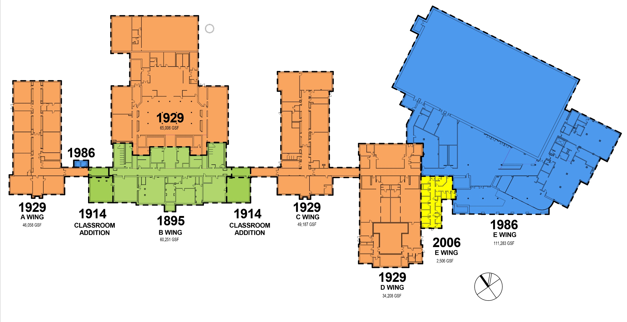
Building History of Construction

Slide 8
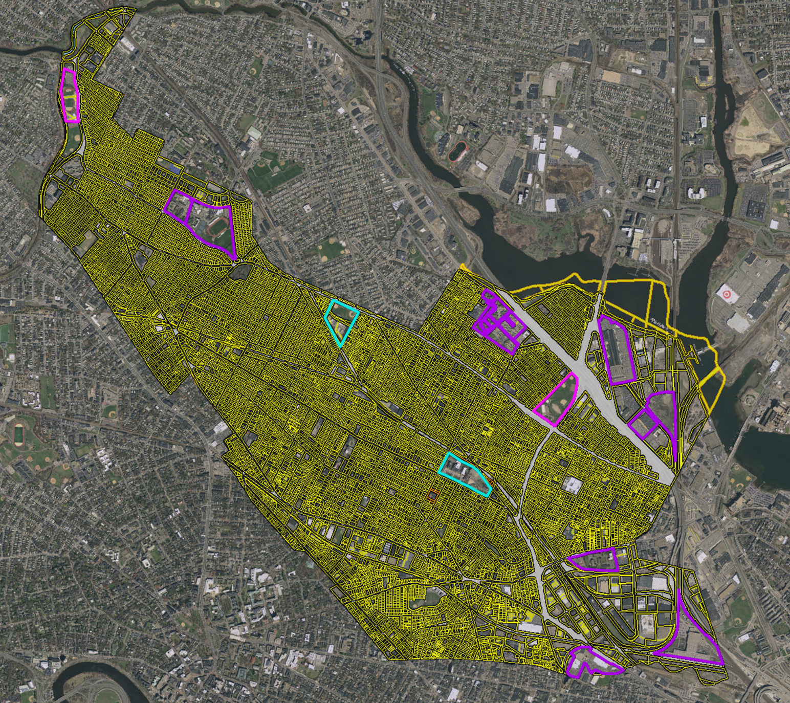

City of Somerville:
Parcels Greater Than 10 Acres
Commonwealth Owned
Privately Owned
City Owned

Slide 9
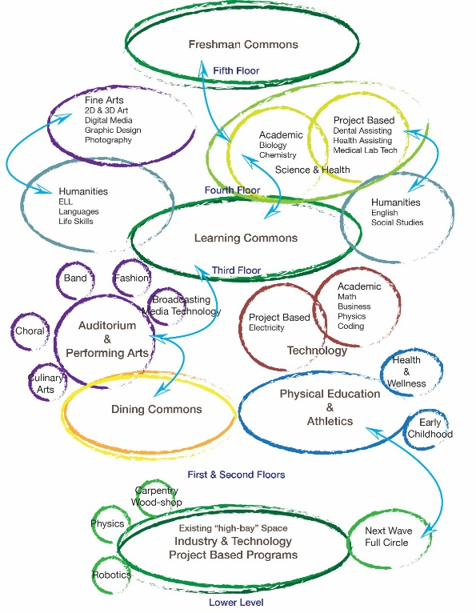
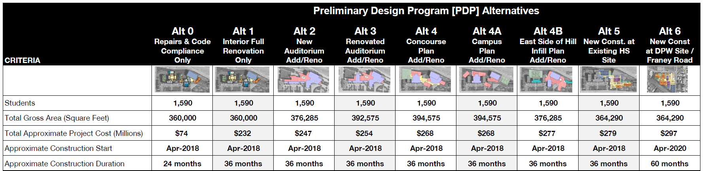
PSR Alternatives
Design Criteria for Option Selection
21st Century Teaching & Learning
  Differentiated Learning
Sustainability
School Safety & Security
Phasing Considerations
Project Costs

Slide 11
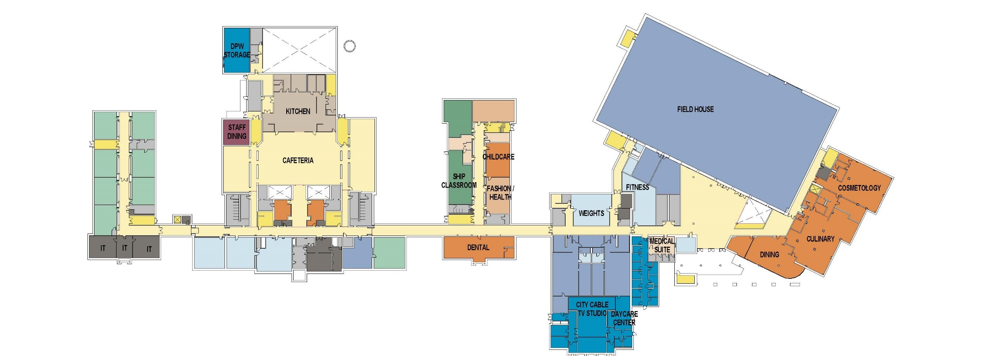
Existing High School:
1st Floor Program Plan
Science, Math and Vocations

Slide 12
Existing Building Deficiencies
Lacking Spaces for 21ST CENTURY TEACHING & LEARNING
  Differentiated Learning
  Comprehensive School w/o Proper Adjacencies
  None/Poor Common Areas
Sustainability and Poor Building Performance
Long Term Viability of 1929 Classroom Wings
Substantial Additions and Renovations Required
School Safety & Security
Science Facilities
Building Organization & Travel Distances

Slide 13
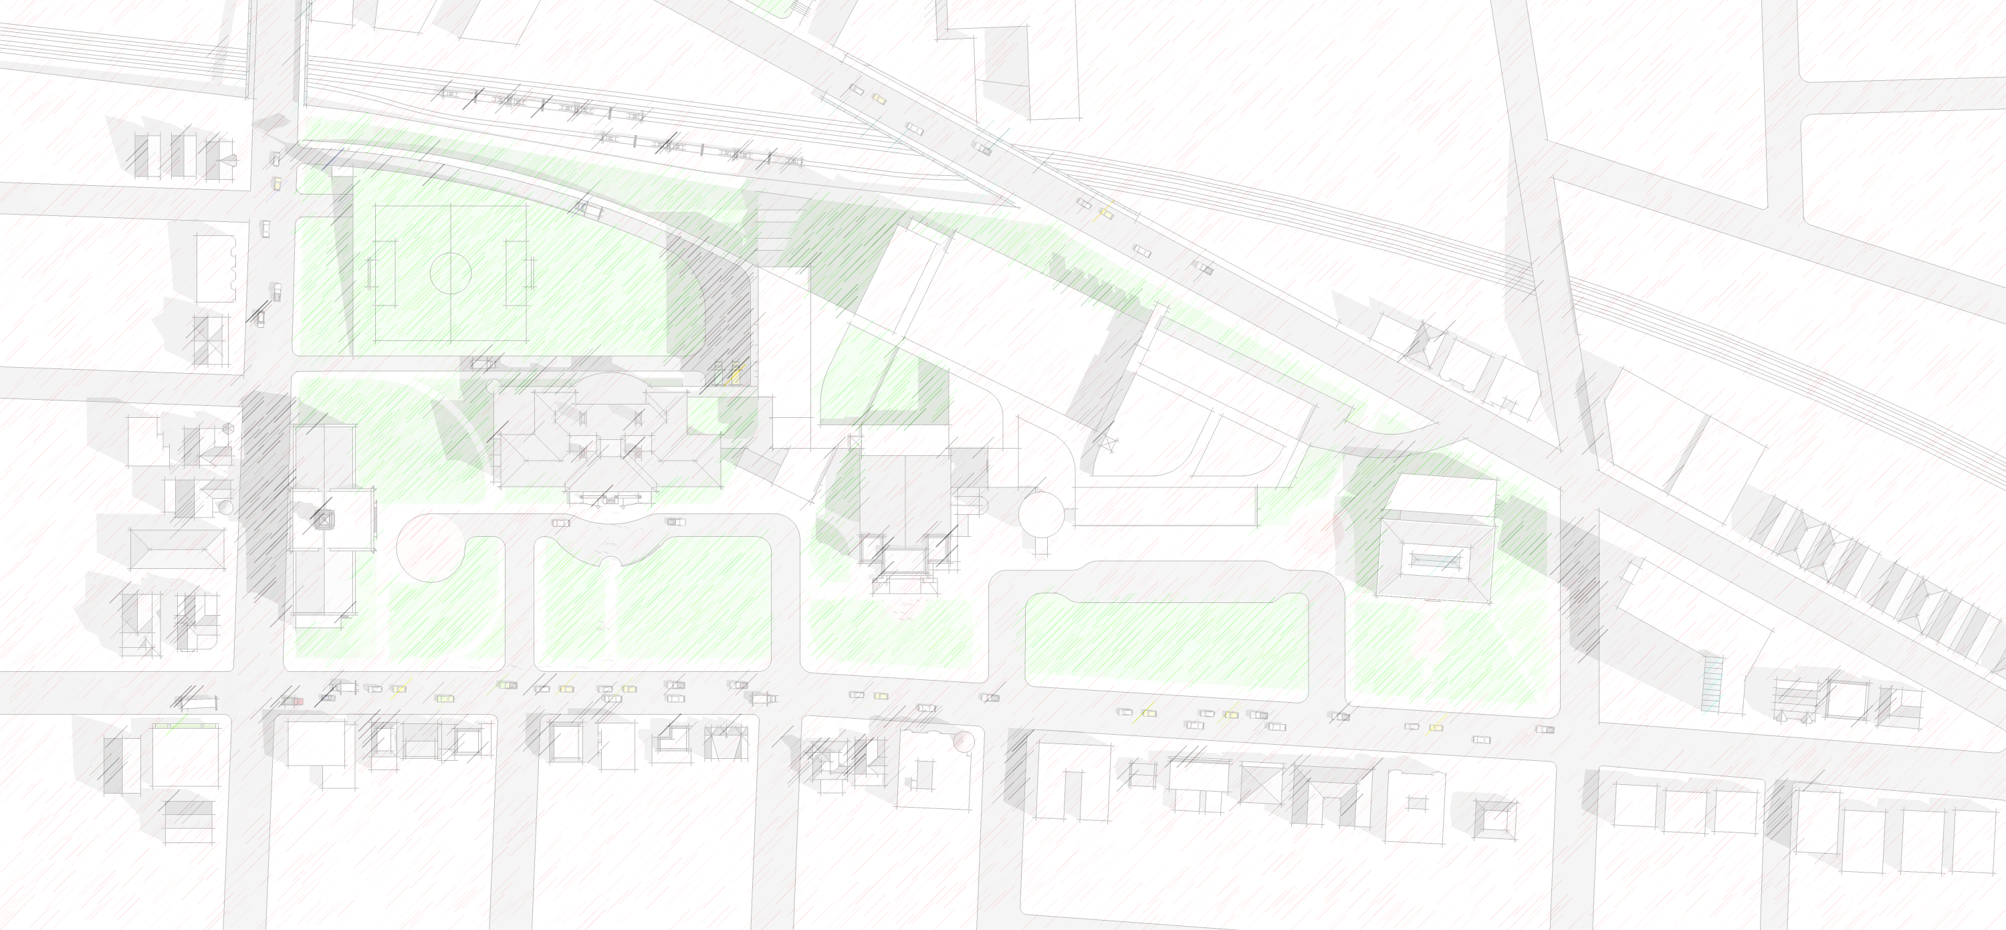
EDUCATIONAL BENEFITS & CRITERIA
CHALLENGES
Phasing & Working Around Existing Buildings
Building Height
Concentrates Students on Tight Site
Physical Relationship to Historic Central Library
Relationship to Highland Ave
Service access
Project Cost
STRENGTHS
Organizational Plan for STEM and STEAM
Integration of Academic and Vocational Programs
Project Based Learning Configurations/Environments
Use of Site & Hillside
Arts Integration
Preserves Critical Historic structures
Community Relationships & Uses
Usable Outdoor Athletic Space
Indoor/outdoor connectivity
OPPORTUNITY
Potential to expand City/Civic programs
Accommodates Next Wave/Full Circle Program
Easy recognition of Commons Areas
Urban Relationships Connecting Gilman & Union Squares
Outdoor learning spaces & environments – Creates Identity for Students
Community Field Use
Parking Clarity

Slide 15
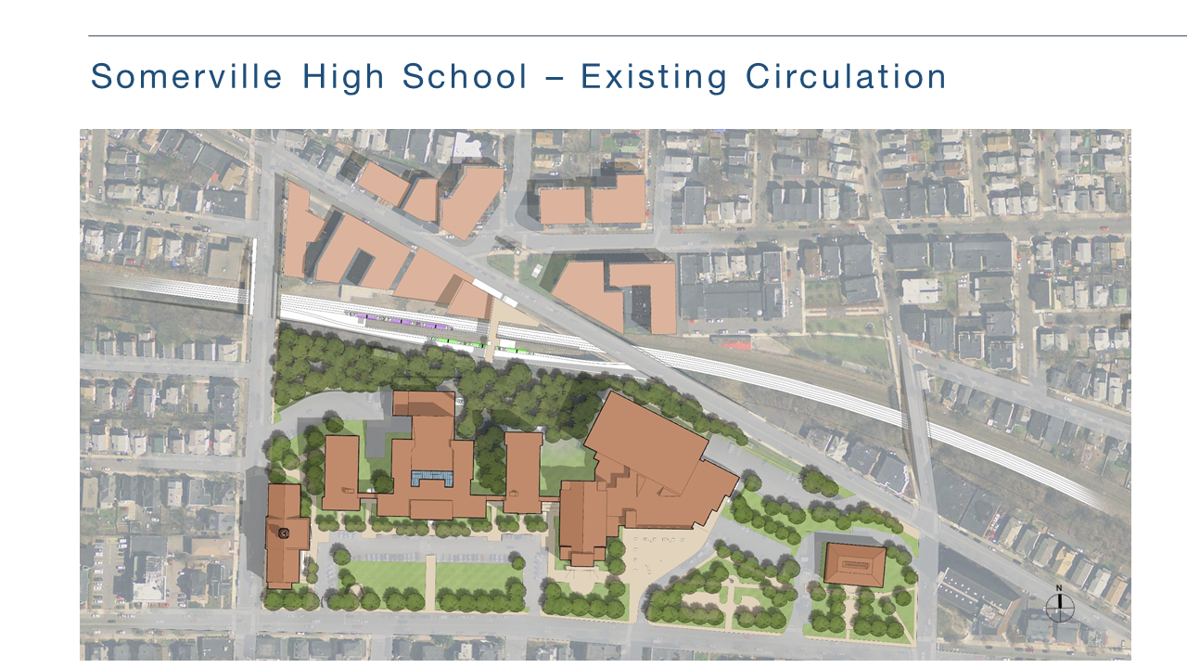
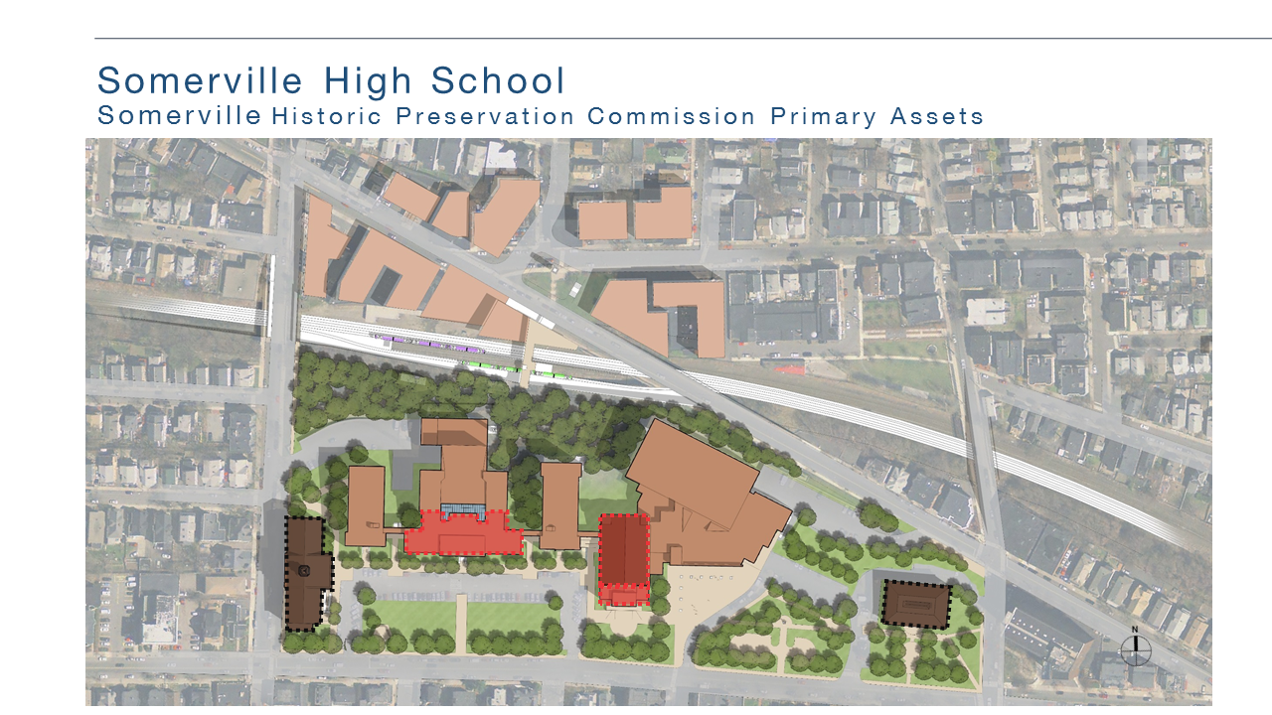

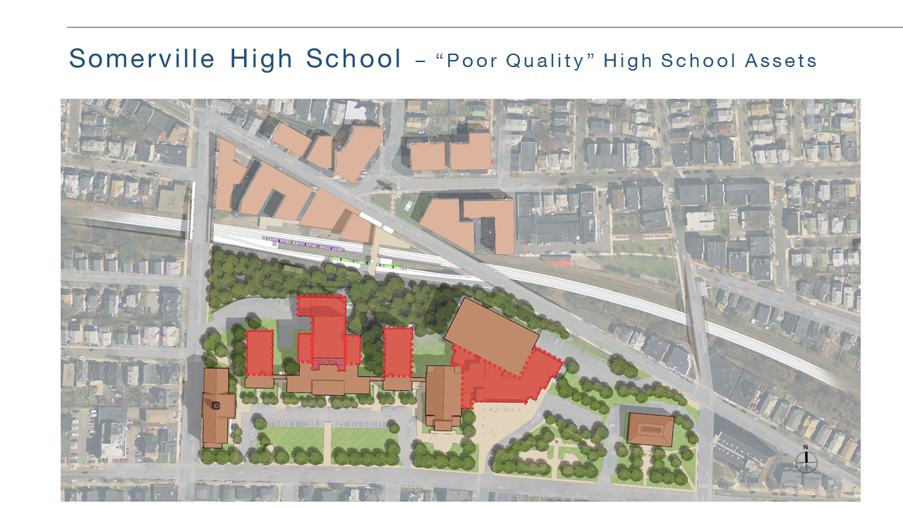
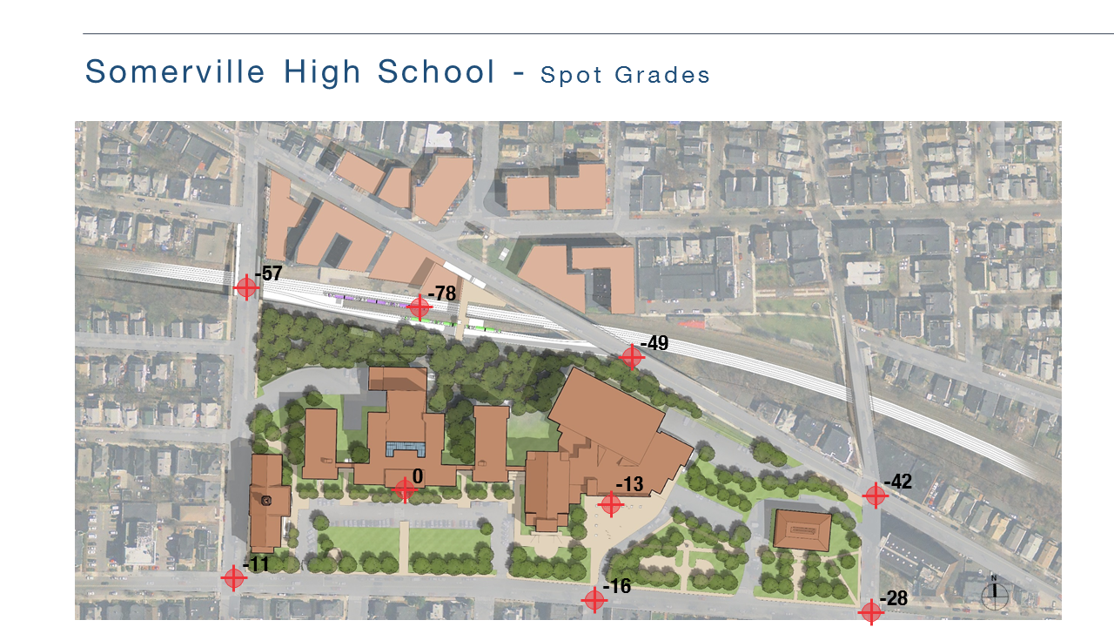

Slide 16
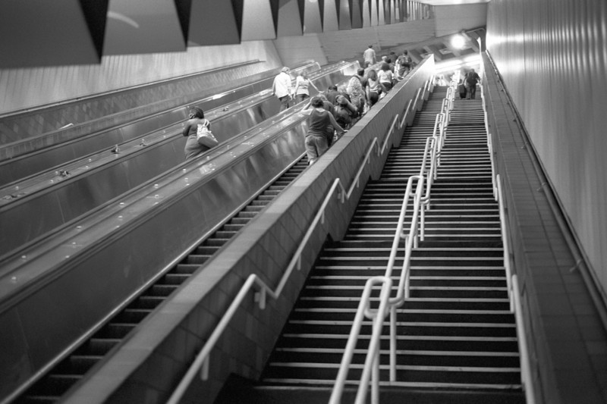
Porter Square Steps – 116 steps to first platform

Slide 17
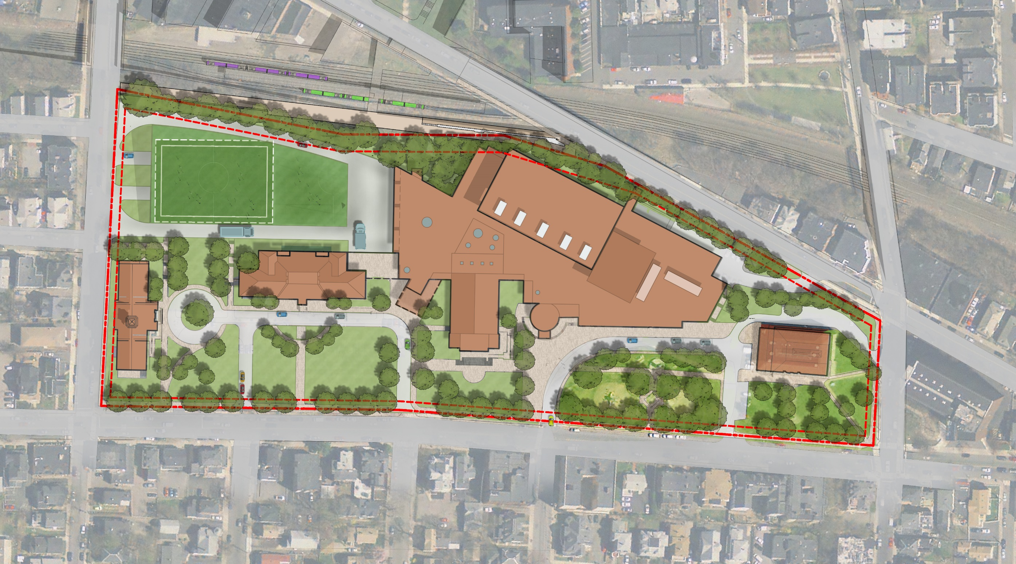
Alternative 4b: Site Plan
Field Above
Parking
GLX Gilman Sq.
Station
Loading
Community Path
Service
Exit
Parking
Entrance
Vocational & Auto-shop
Entrance and Loading
Service
Entrance
Civic
Entrance
Community
Entrance
Auditorium
Entrance
Main School
Entrance
Drop-off

Slide 18
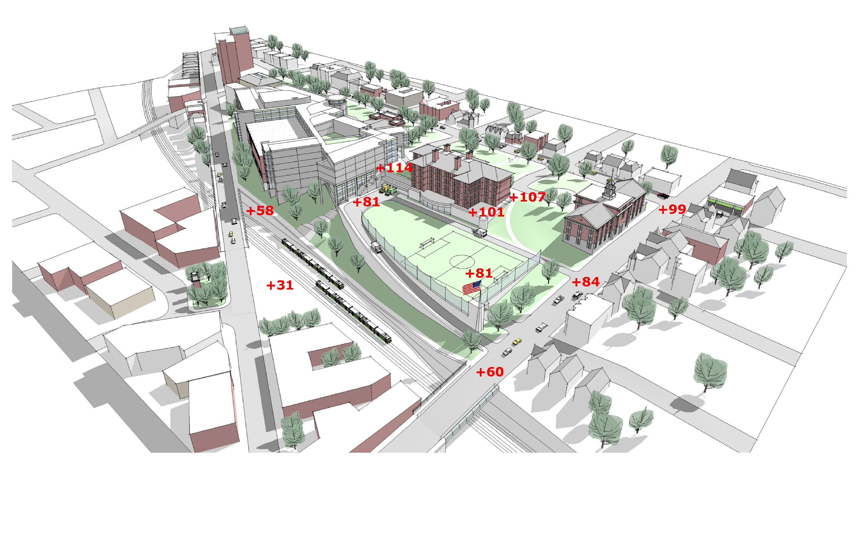
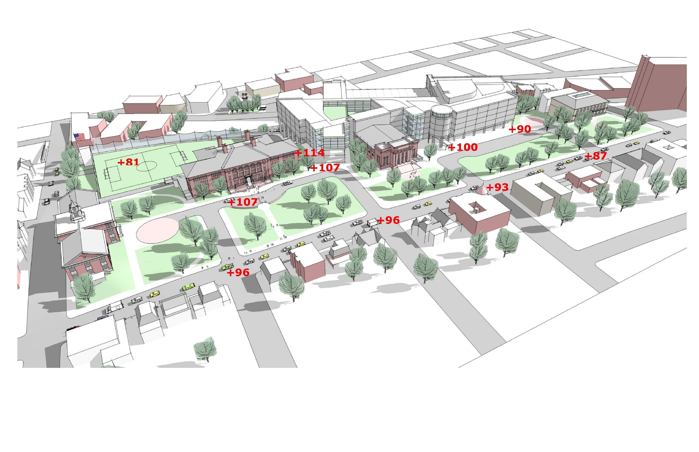
Somerville High School – Spot Grades

Slide 19
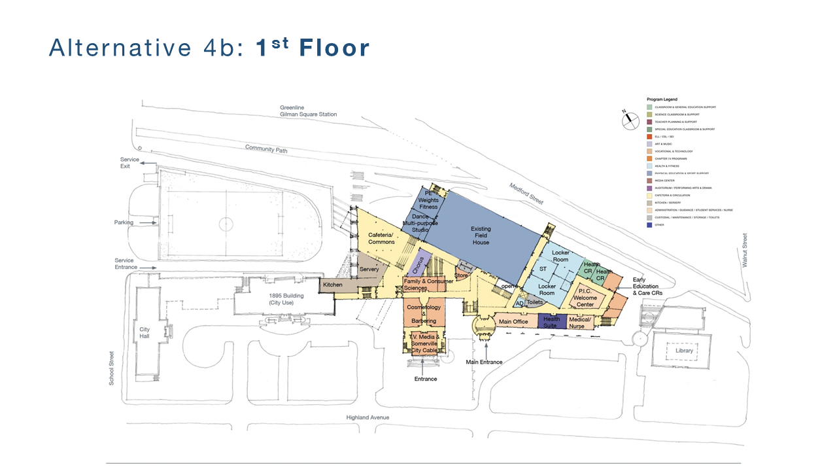
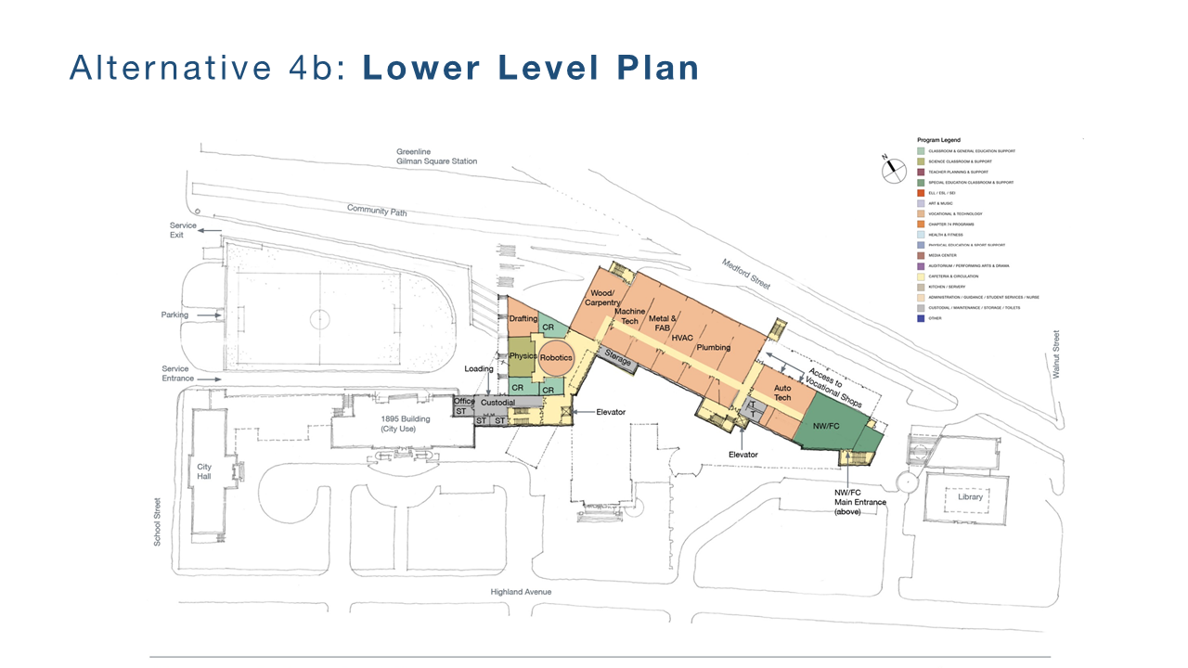
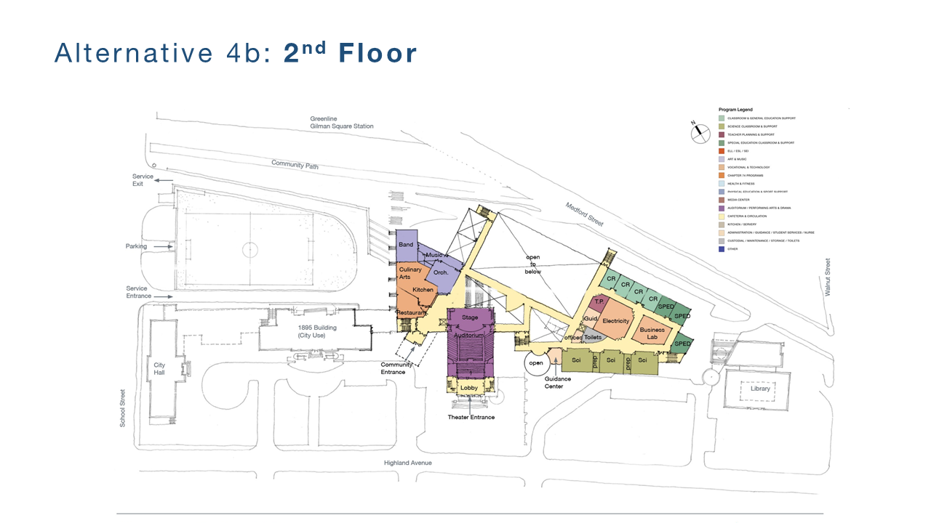
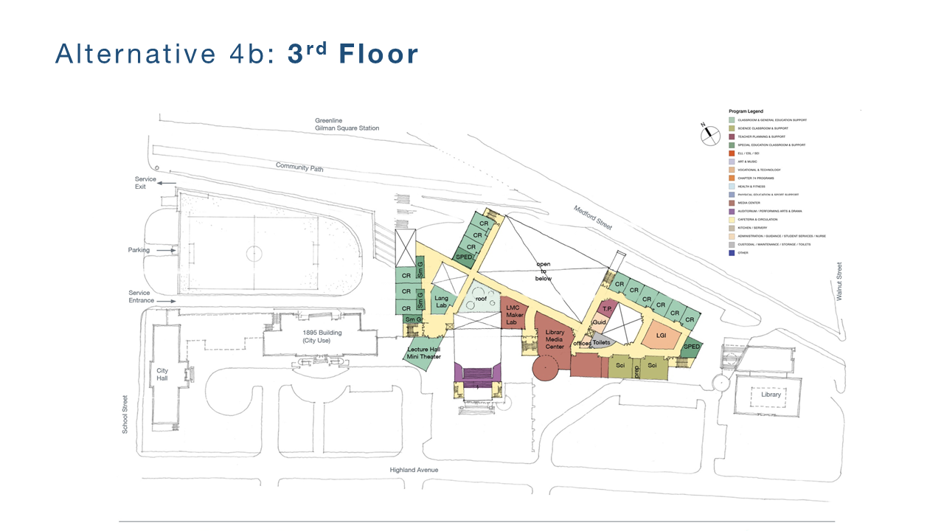
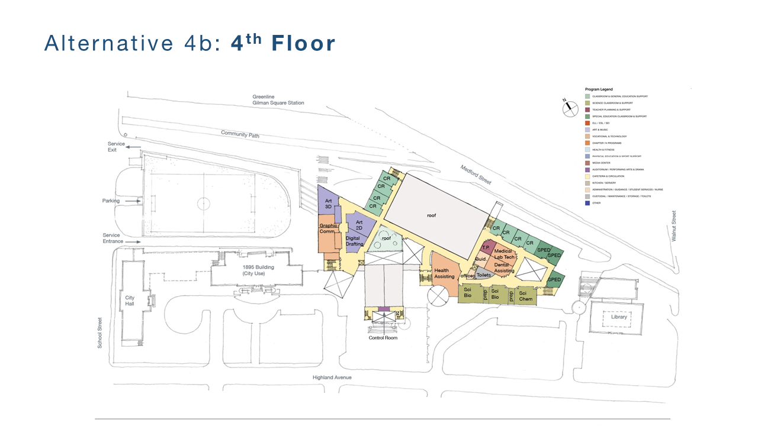
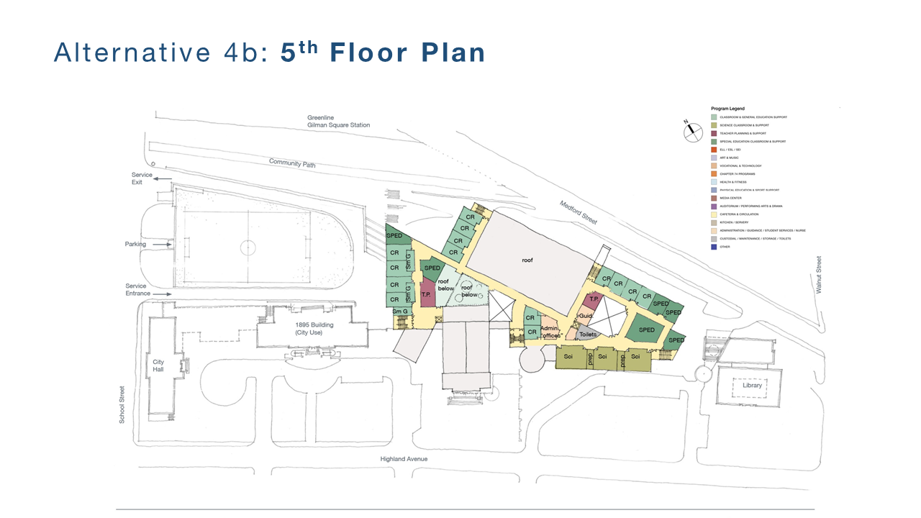
Freshman Experience
English
Social Studies
Languages
Math Classrooms
General Science
SPED
Commons Space & Media
Existing Condition – Major Public Event Spaces
Academic Zones
Commons & Core Areas as Bridge/Link
Humanities
English
Social Studies
Language
ELL
Life Skills
Mini-Theater
Performing Arts
Drama
Chorus & Dance (below)
Band
Orchestra
Fine Arts & Technology
2D & 3D Art
Digital Art
Graphic Design
Drafting
Photography
Humanities Classroom
STEAM
Physics
Heavy Shops
Drafting/Engineering
Wood/Scene Shop
Math
Athletics
Dining Commons
Next Wave/Full Circle
Health Sciences
Biology
Chemistry
Dental Assisting
Health Assisting
Medical Lab Technology
Math Classrooms
Semi-Public Programs
Technology & Mathematics
Electricity
Math Classrooms
Business Labs
Physics
Learning Commons/Media Center

Slide 20
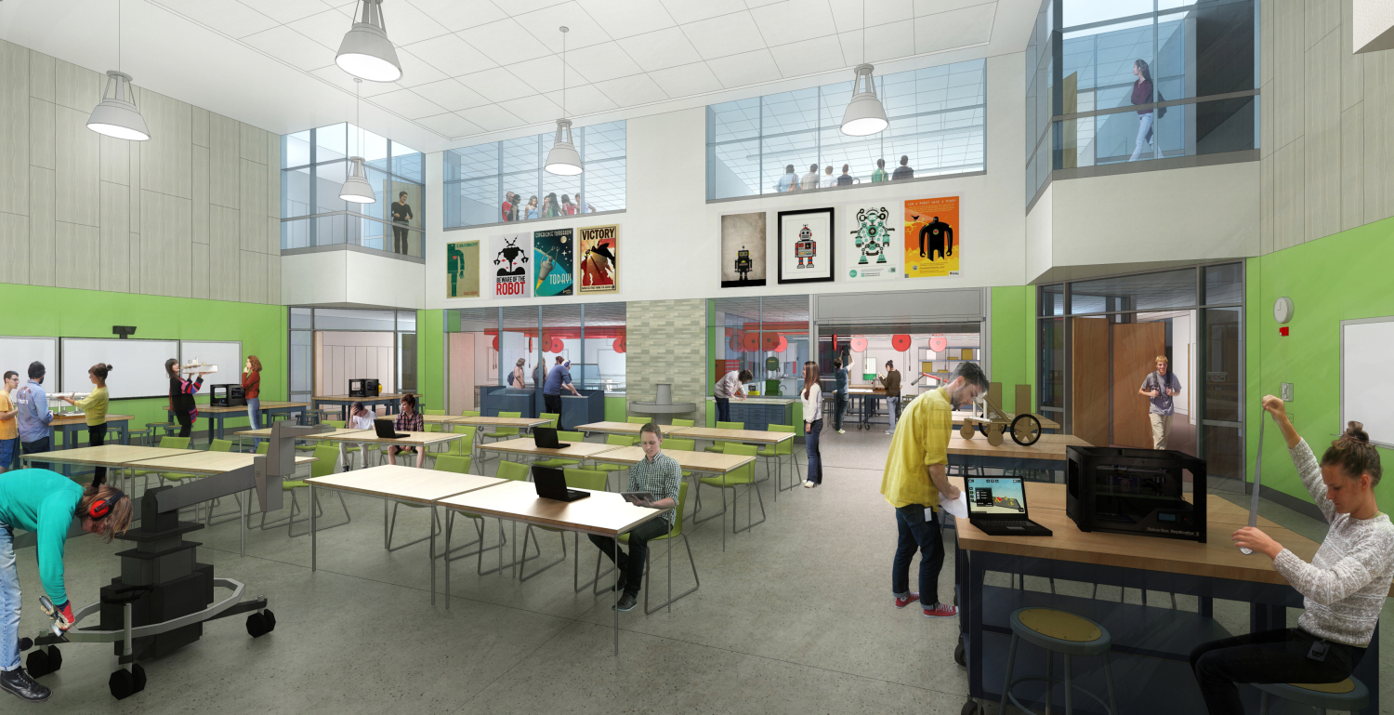
Fab Lab

Slide 21
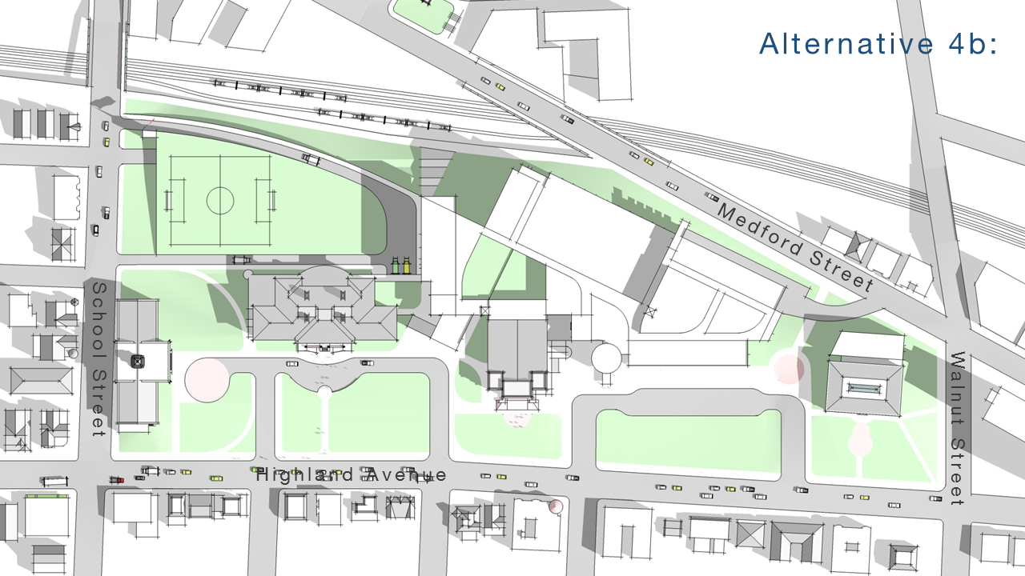
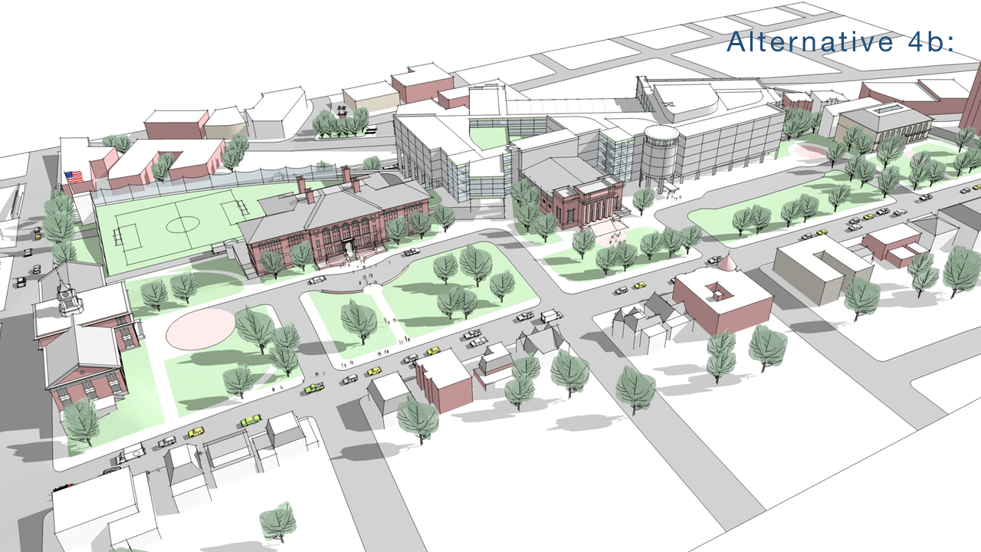
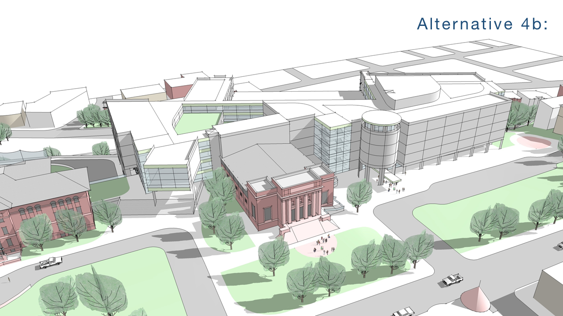
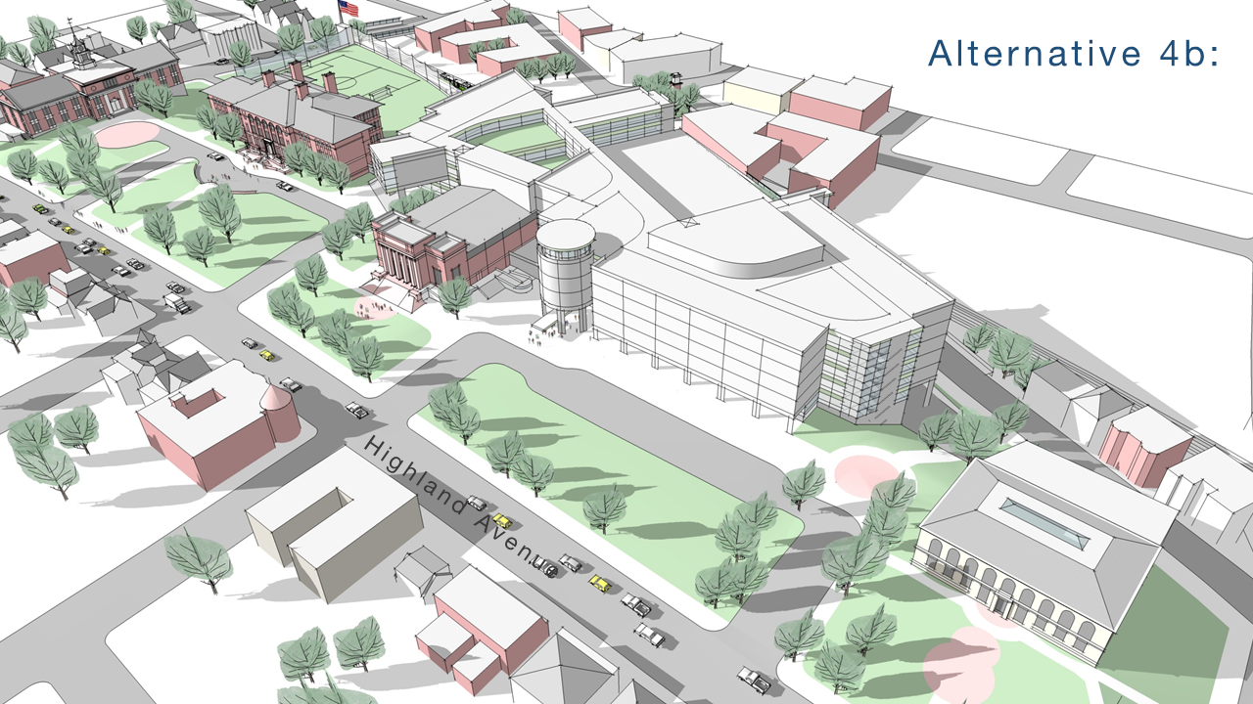
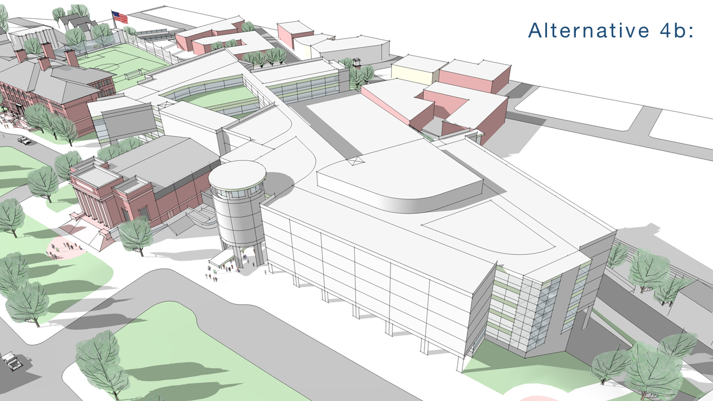
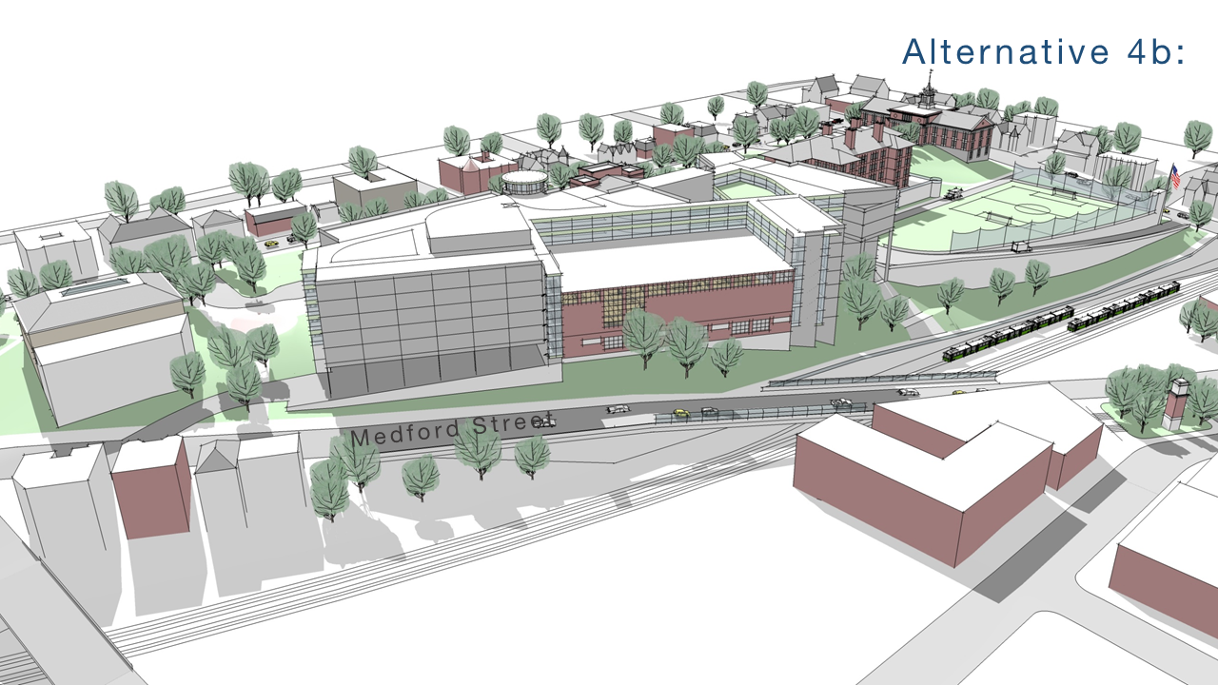
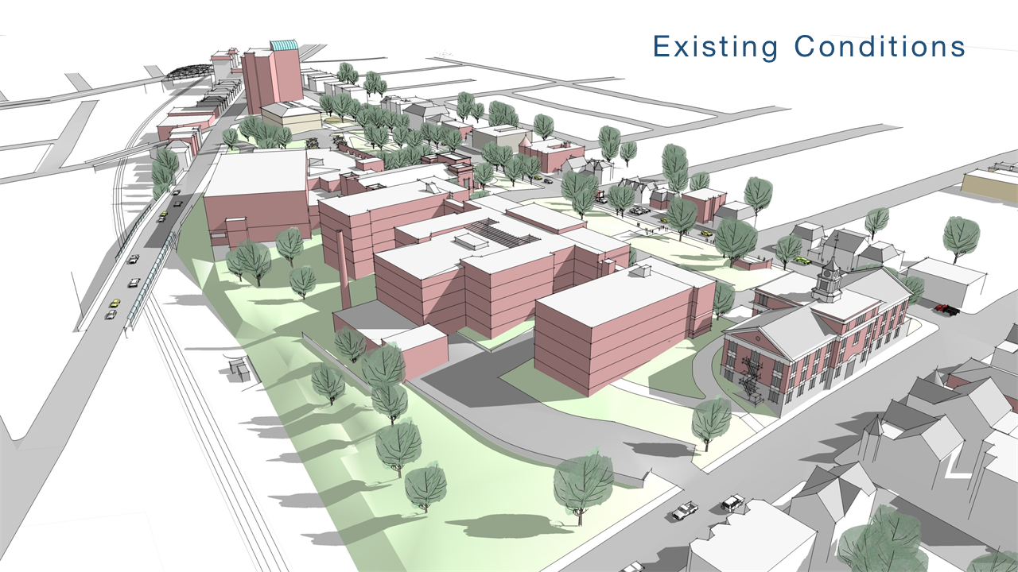


Slide 22

Field and Venue
Inventory
Somerville High School Field House
Veterans Memorial Hockey Rink
Conway Park
Fall: Football Practice
Spring: Little League
Dilboy Stadium
Fall: Football
Spring: Track
Trum Field
Spring: Baseball & Softball
Foss Park (DCR)
Fall: Soccer Practice
Spring: Softball, Ultimate Frisbee
Blessing of the Bay Boathouse
Crew
Kennedy School
J.V. Basketball
Argenziano School Field
Girl’s Soccer Practice
Ultimate Frisbee
East Somerville Community School
Freshman Basketball
Soccer Practice
Capuano Early Education center
Soccer Practice
Draw Seven
Soccer Field

Slide 23






Highly Sustainable &
Energy Efficient Design
Cost
Effective
LEED v4 Silver Rating
2% Additional Reimbursement
Sustainability
Long Term Environmental Impact
Educational Benefits

Slide 25






MSBA Process– Somerville HS Timeline

Slide 26

Feasibility/Schematic Timeline
2016
2017
JULY
AUG
SEP
OCT
NOV
DEC
JAN

Slide 27




Budget Development
THREE Estimating efforts (Two of those performed by 3rd party independent estimating firms)
THREE Unique methodologies
ALL Reconciled to within 0.8%

Slide 28

Phasing & Early Cashflow Projections

Slide 30

Projected 30-Year Debt Service

Slide 31
Full Debt Service Payments Start in 2026

Slide 32

Projected Impact of Debt Exclusion

Slide 33
Projected Impact of SHS on Property Tax
Based on FY2016 Average Values

Slide 34
Mitigation Options Under Review
Building Permit Revenue
Sale of Assets
Reserves

Slide 35

Building Permit Revenue Projections
The Long-Range Forecast assumes $3.5M in annual building permit revenue ($35M over 10 years).
However, if development timelines are realized as currently anticipated, the actual value of building permit revenue would exceed this by $30M+.
Actuals
Projections

Slide 36
Framework for Sale of Assets
Assess programmatic space needs
Assess ongoing energy, maintenance, and repair costs
Determine highest and best use options under current and proposed zoning
Conduct cost-benefit analysis of continued use vs. sale
Maintenance costs
Energy costs
Systems and facilities needs
Estimated sale revenue
Projected tax revenue once back on tax rolls

Slide 37

City Building Assets and Consolidation Planning
Six buildings currently under review:
  Edgerly School - 8 Bonair St.
  Cummings School - 42 Prescott St.
  School Admin Building - 42 Cross St.
  Recreation Building - 19 Walnut St.
  City Hall Annex - 50 Evergreen Ave.
  Traffic & Parking, 133 Holland St.

Slide 38
Prioritizing Reserves for Capital Investments
Stabilization Fund Balance
Annual Free Cash Certification
Notes:
Additionally, during the past twelve years we have used one-time revenues and free cash to shore up our stabilization funds to the highest levels in the City’s history. This again allows us to reduce the need for borrowing as well as have a backup plan if unforeseen expenses arrive at our doorstep. Difficult situations such as last Winter’s snow removal deficit no longer have the ability to influence multiple years’ worth of operating budgets as we have created rainy day funds and reserve balances.

Slide 39





Building Connections: Linking Gilman Square to Union Square via the Central Hill Civic Campus

Slide 40

Thank you!

